Slide 1
Presentation on
Project Art Gallery

Slide 2
Guided by : Dr Razib Hayat Khan Sir
Group No: 09
Section: A
Group Members :
Kakon, Khairul Islam 20-42438-1
Wasif Ahmed 20-44137-2
Kaniz Fatima 20-43137-1
Subrina Khan Authoy 20-42221-1
Raihan Sikder Anik 20-43166-1

Slide 3
Outline
Introduction
Requirement and analysis
Design
Managing Criteria
Testing
Conclusion

Slide 4
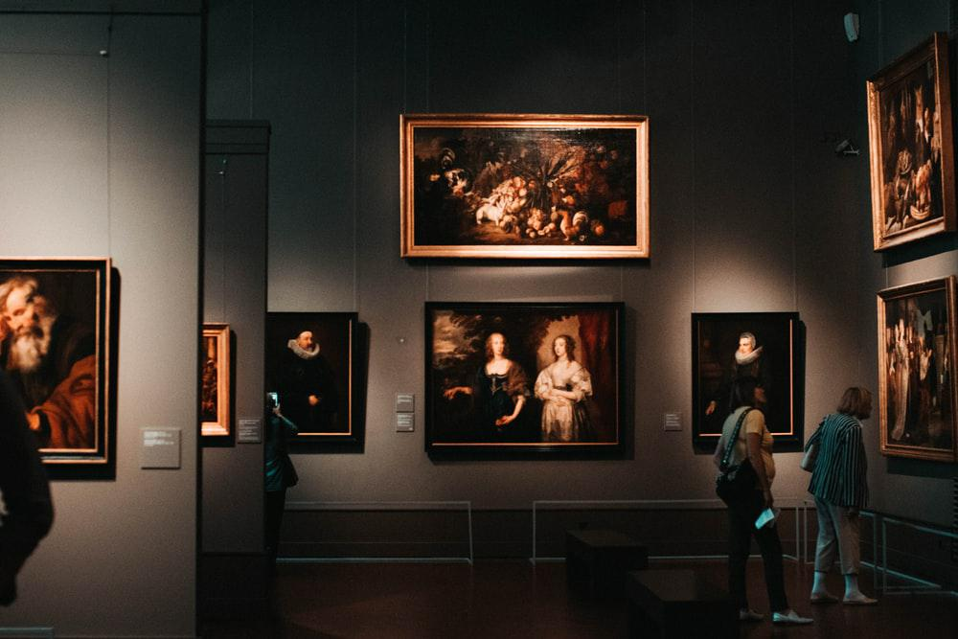

Introduction
Abstract
Making a bridge between artist and art loving audience .
Why do we need?
Lack of platform in arts and crafts. Approximate 12 art galleries in Dhaka.
What will be the opportunity?
Local artist will have a platform. They will get publicity and a source to bid his/her art.

Slide 5
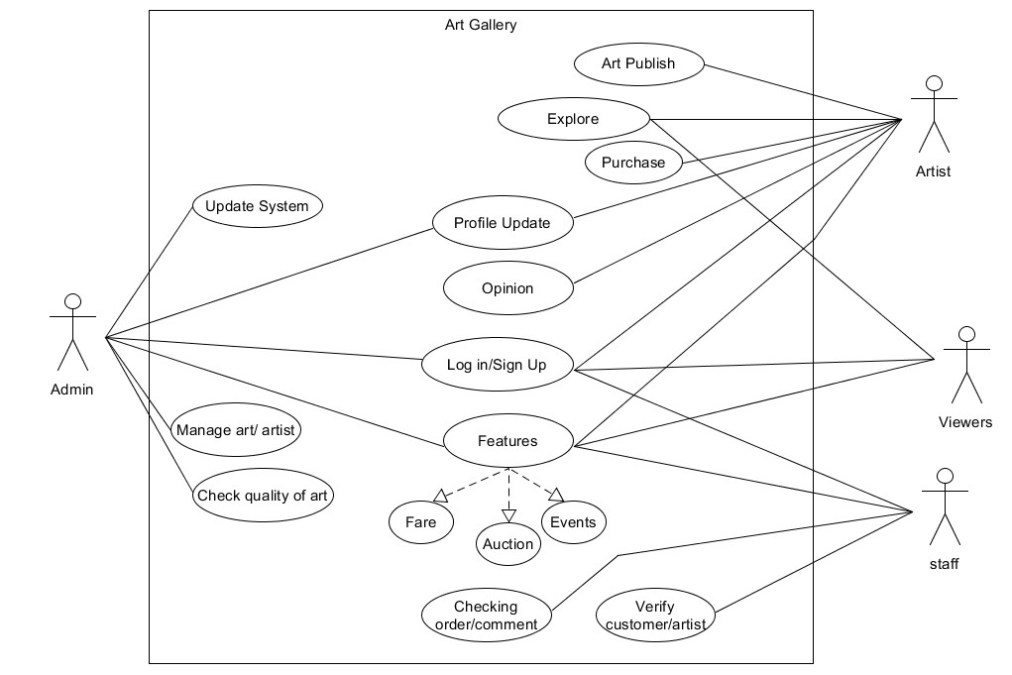
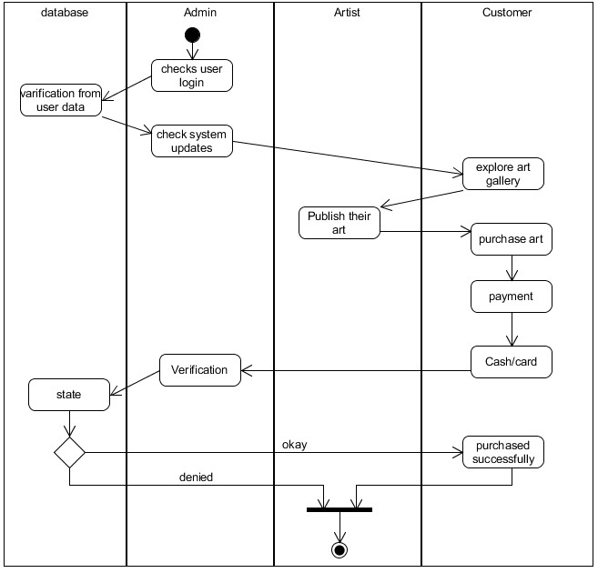
Requirement and analysis
Purpose
Making a software that will help artists to publish their art to the world where all the audience will be able to view, react and they can purchase
Activity Diagram
Use case Diagram

Slide 6
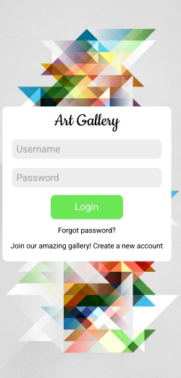

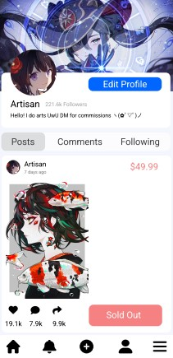
Design
Log In page
Homepage
User Profile Page

Slide 7
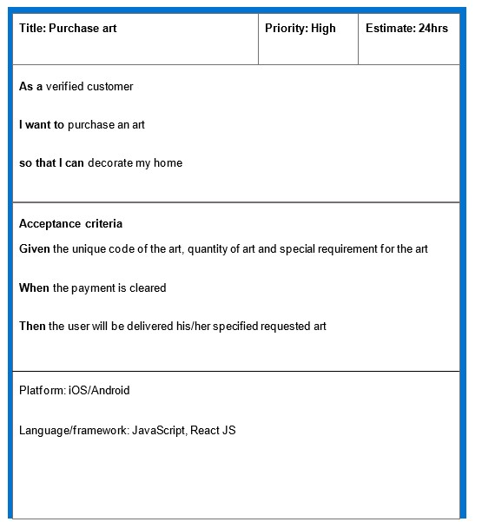
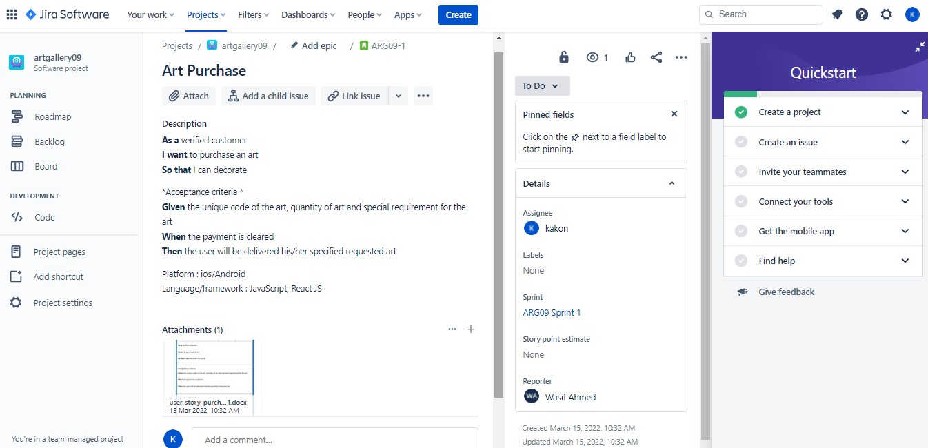
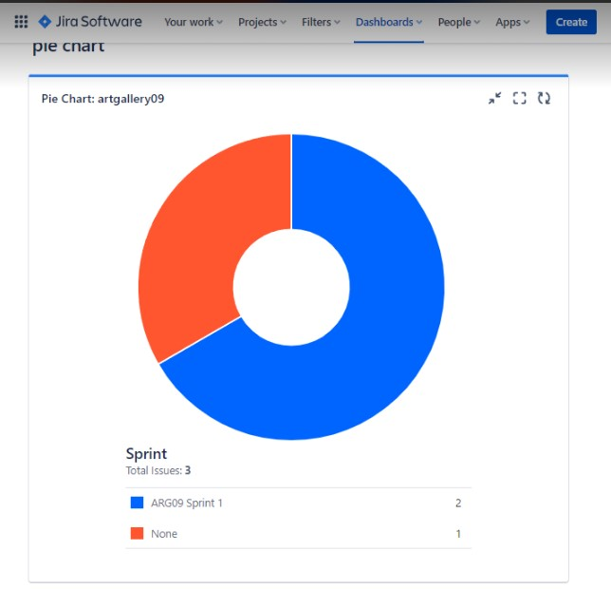
Managing Criteria
User story card
JIRA project management
Sprint pie chart

Slide 8
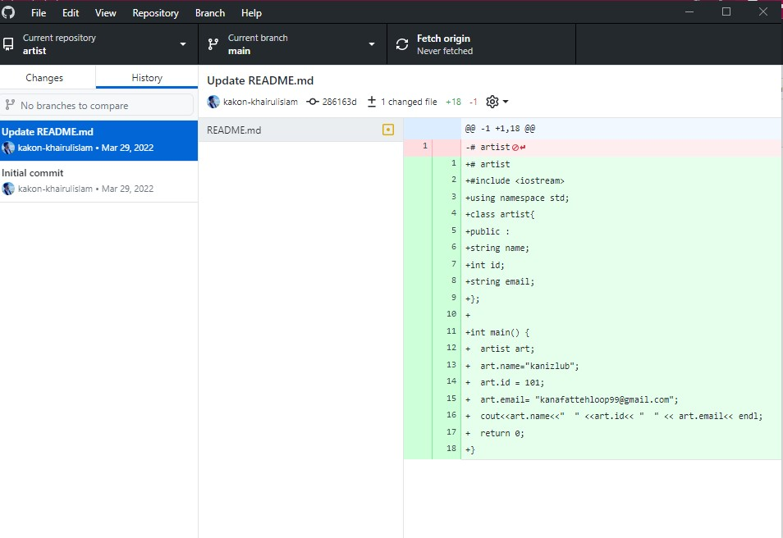
Testing
GitHub

Slide 9
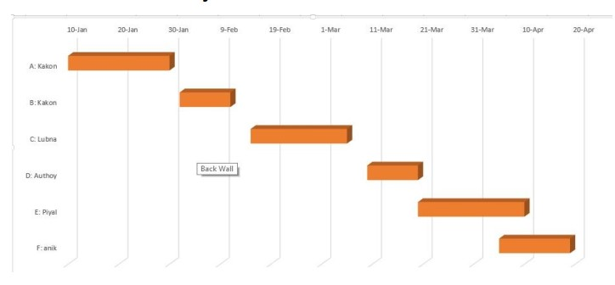
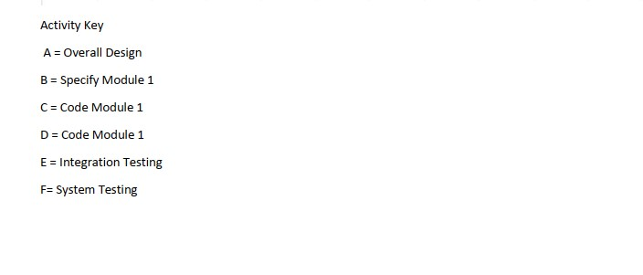
Testing
Timeline Chart

Slide 10

Conclusion
Our Software aims to provide more audience friendly service and tries to be feasible. Our software was designed for the special target to make proper room for both artist and audience who loves art. Our Software will be updated as per feedback .

Slide 11


